Slide 1
Tiny Toes
A complete Maternity Guide
CP301 : DEP
Arshdeep Singh (2020CSB1074)
Inayat Kaur (2020CSB1088)
Ruchika Sharma (2020CSB1119)
Ayushi Patel (2020CSB1080)
Consultant : Dr Garima
Mentor : Dr Puneet Goyal

Slide 2
ACKNOWLEDGEMENT
We are elated and satisfied with the progress of our project Tiny Toes. We would like to acknowledge and thank all the individuals who helped us throughout the course of this project.
First and foremost, we extend our sincerest thanks to our mentor Dr Puneet Goyal for entrusting us with this project and providing valuable insights and feedback throughout the development process. Your guidance and support have been invaluable in shaping the final outcome and ensuring its alignment with your vision and requirements.
We would like to thank Dr Garima for providing us with her valuable and knowledgeable feedback that helped us immensely. Your collaboration and professionalism to excellence have been instrumental for our project.
Our heartfelt gratitude to the seniors who initiated this project idea and provided us with valuable insights.
Lastly we would like to thank the TAs who guided and provided us with regular feedback and suggestions.

Slide 3
PROJECT IDEA DESCRIPTION
Tiny Toes is a free health application dedicated to women out there to help them during and also after their pregnancy. It is an all-in-one mobile application designed to be the ultimate companion for expectant and new parents. With its comprehensive set of tools and features, the app aims to support and guide users through their entire prenatal and postnatal journey and ensuring a healthy and informed experience.

Slide 4
Why Tiny Toes ?
There are a lot of confusions and concerns regarding pregnancy in women. Even today many women lack knowledge and resources to take proper care of themselves. With the concept of nuclear families we don’t have elders around us to guide woman through her pregnancy and post pregnancy period.
The aim of our project is to develop an application that helps pregnant woman to track their pregnancy and take proper care of themselves and their babies free of any cost.
Although, there are applications available for it but not all the essential features are available at the same place. Also, these applications require payment for using some of their premium features.
Therefore, our idea is to combine all the important features and make a free application to help the expectant mothers out there.

Slide 5
OUR AIM
Our aim is to provide woman with a free easy to use and interactive application that contains all the tools and information that can help a woman during pregnancy and after childbirth as well.
We analysed all the already existing applications available on Playstore and Apple Store and analysed them thoroughly.
We were able to prioritise the features and we proceeded with the most feasible and necessary features.
Here is the link to our detailed analysis -
https://docs.google.com/presentation/d/13mQz22VSfGnyBJk2X5nNRMe7ukOKrV0GXxp7oKQPR1k/edit#slide=id.gc6f889893_0_0
https://docs.google.com/spreadsheets/d/1hUCWg5dTi-_v_TZPv8PEbTKEvupCRo7B/edit?usp=sharing&ouid=100600916571448704941&rtpof=true&sd=true

Slide 6
TESTIMONIALS
Dr Garima (PGIMER)
The app looks really promising as the world is moving towards AI. I personally feel that, if this application if used properly it can be very beneficial in providing basic health care just a click away for pregnant women.
This app looks user-friendly and is easily operable even in offline mode. The best thing is data retrieval which can be very helpful for physicians overall.

Slide 7
A Glimpse of
TINY TOES

Slide 8
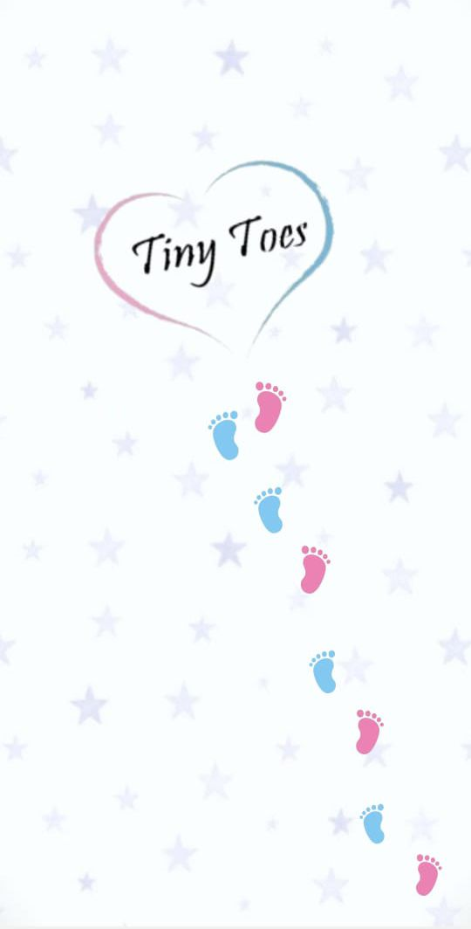
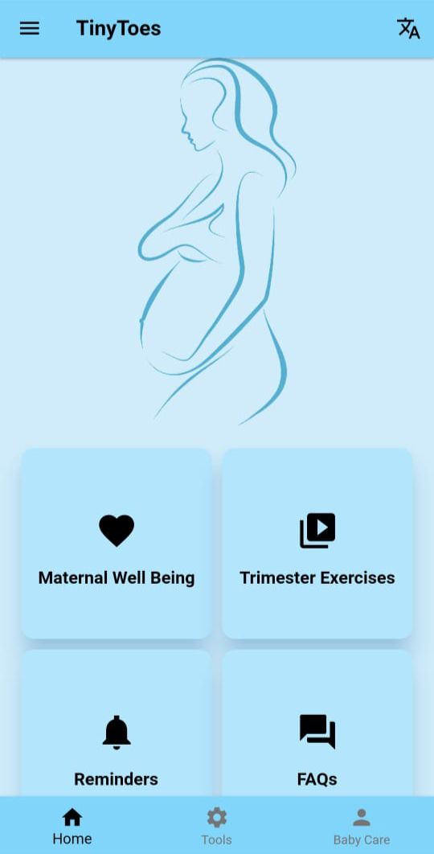
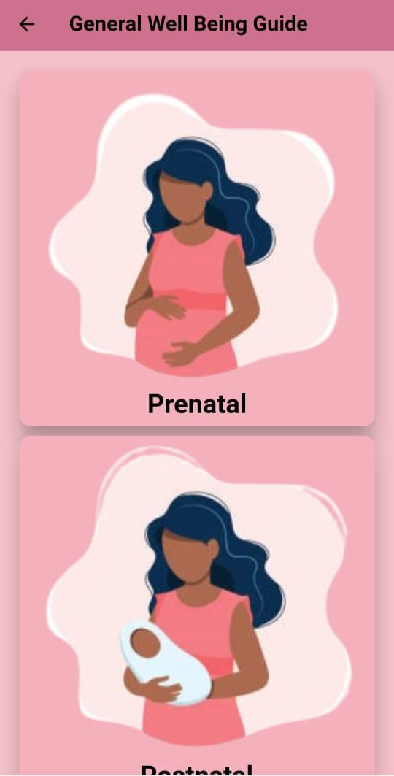
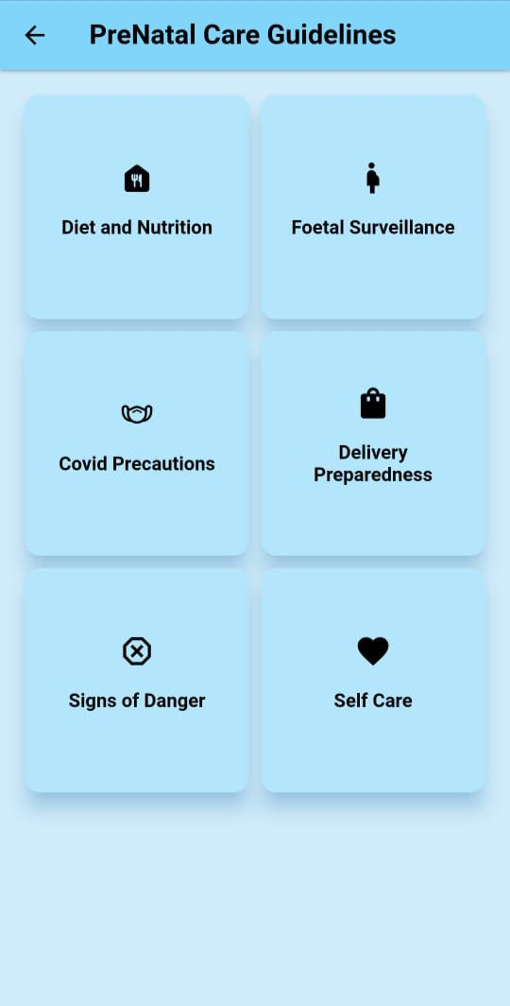
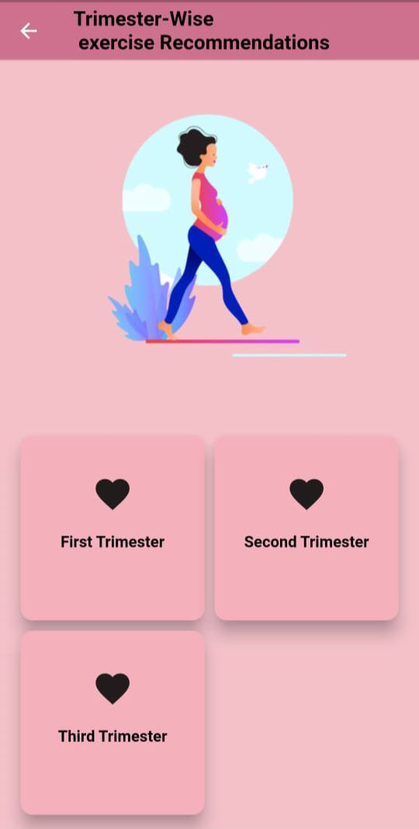
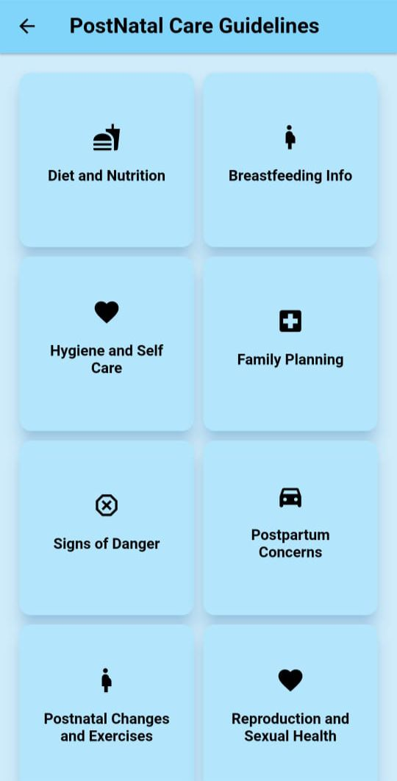
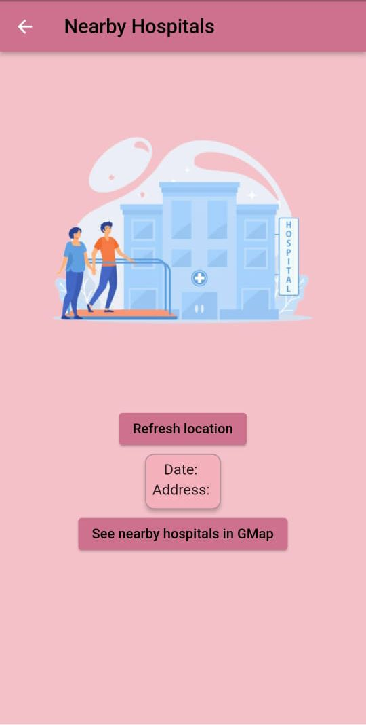
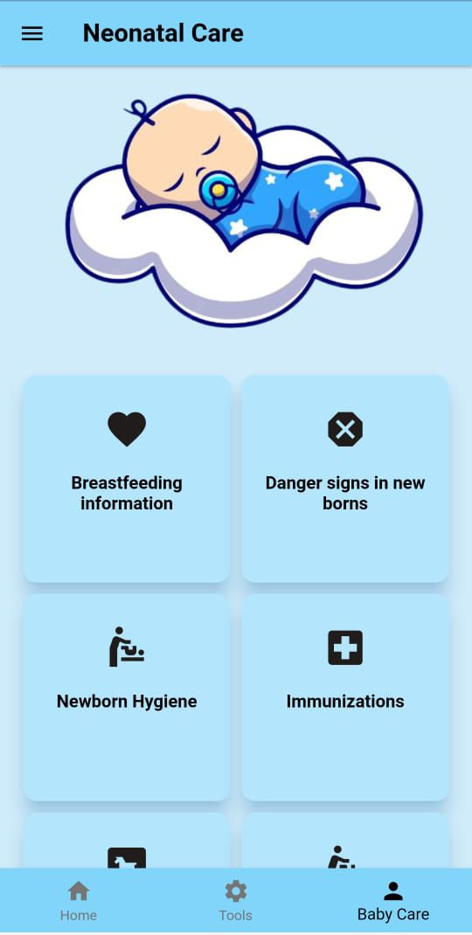
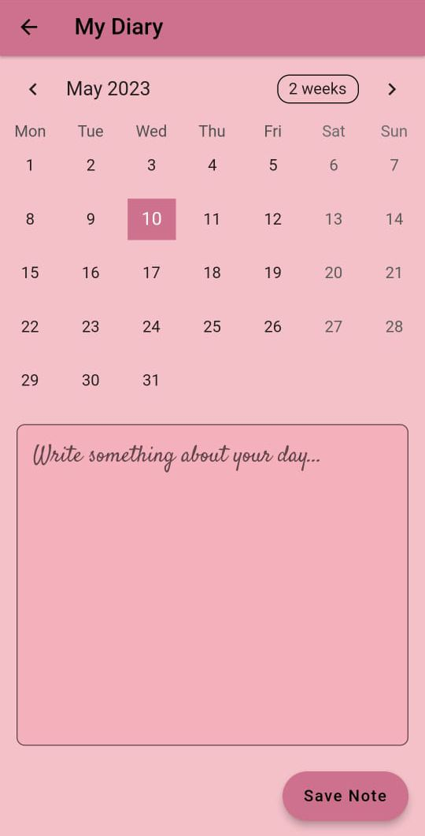
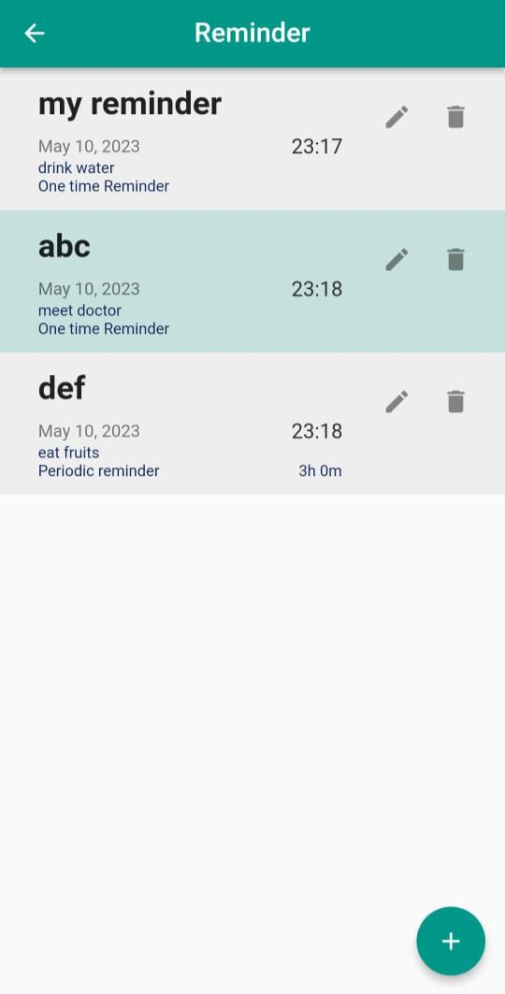
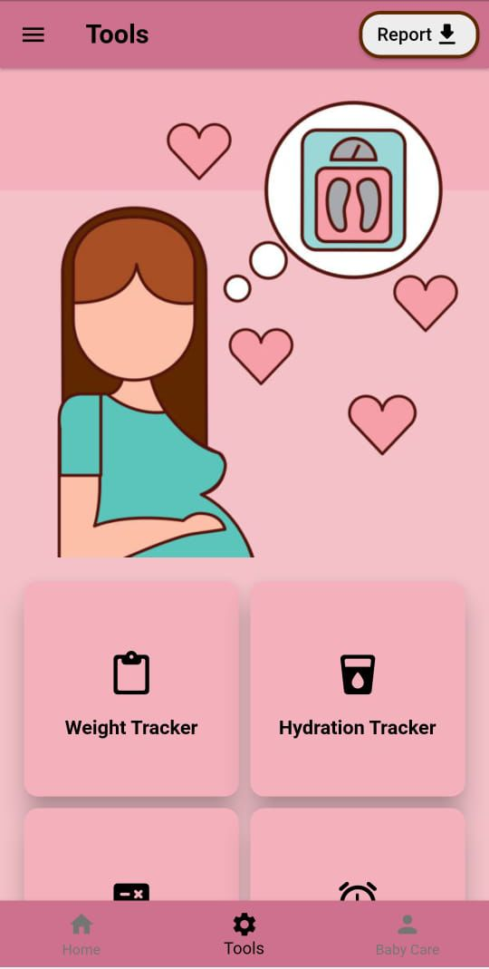
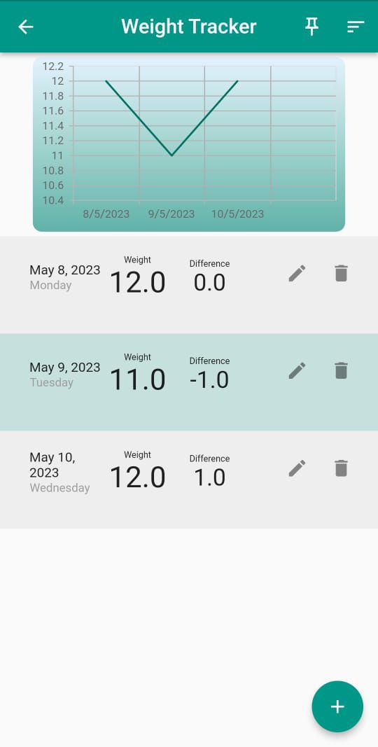
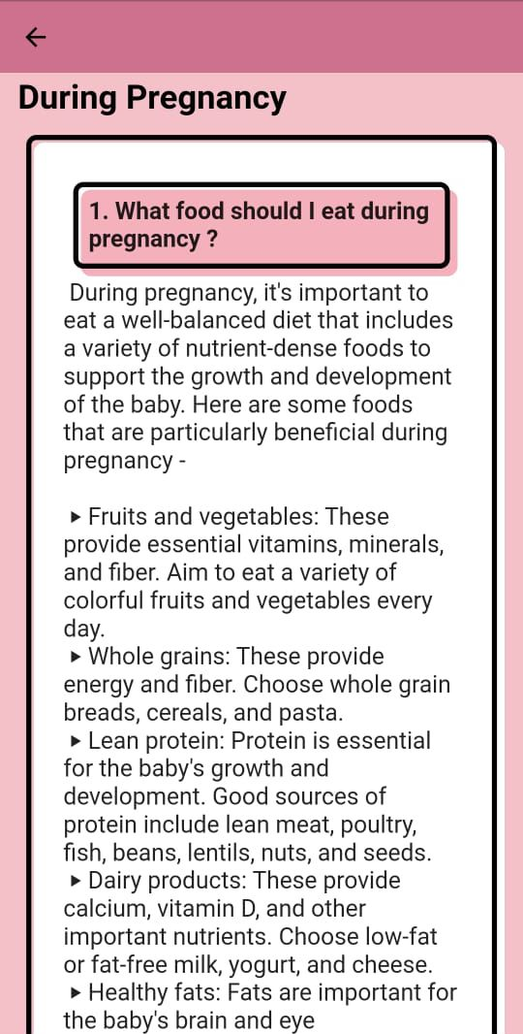
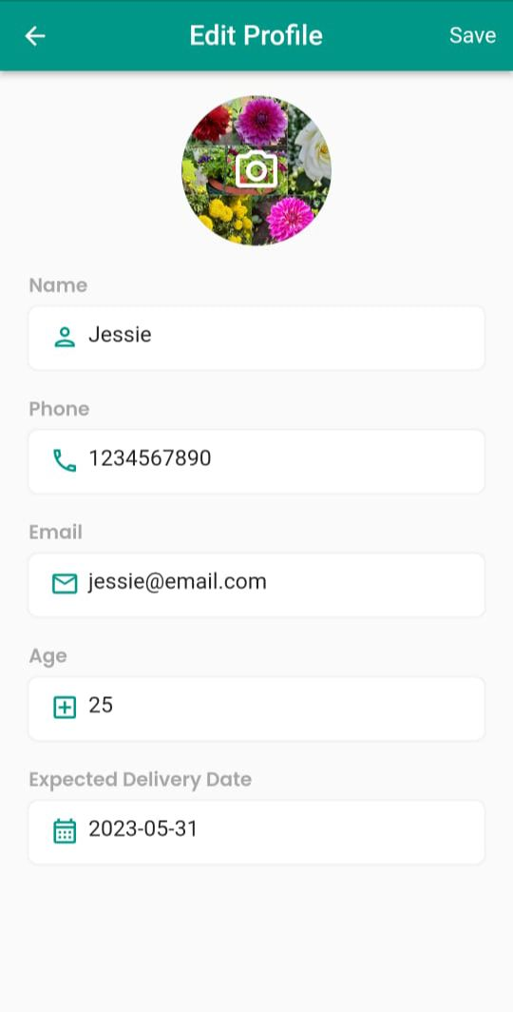

Slide 9
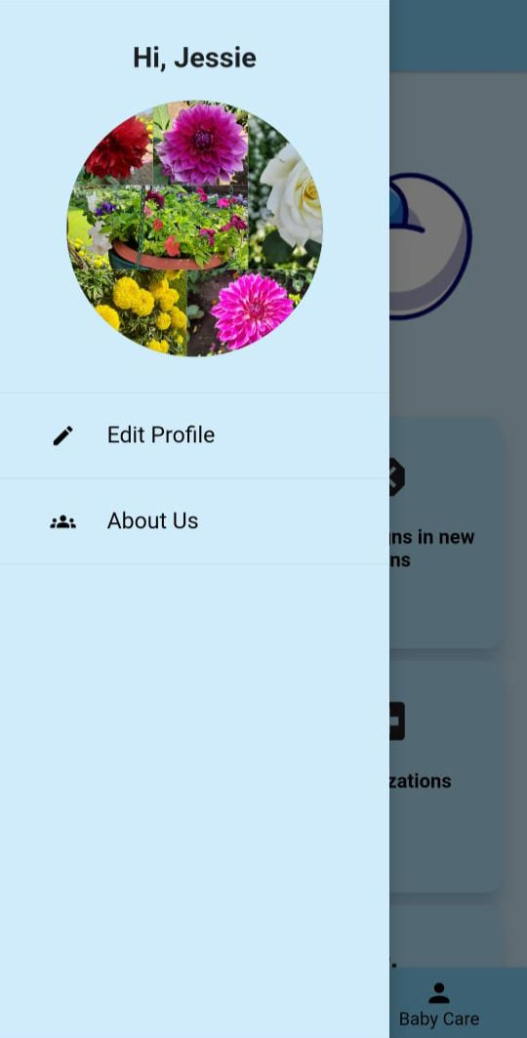
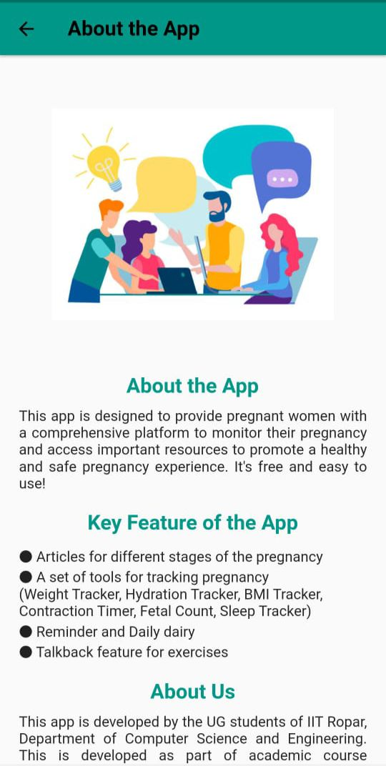

Slide 10
Multilingual Support is available
Home Screen
It consists of 4 main sections which are described here. Apart from that on top left corner we have a drawer that allows user to edit profile and view the about us section of app.
Trimester Wise Exercises with Multilingual Audio and Visual Support
This section offers you further two sections - Post and Pre Natal
Answers to some frequently asked questions by mothers
Allows you to set reminder for important activities

Slide 11
This section contains all the resources required during pregnancy
This is the FAQ section which answers all the basic and necessary questions.
This section contains all the resources required after childbirth.

Slide 12
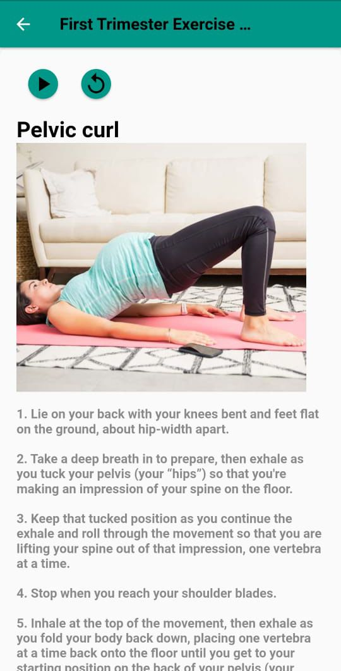
Here, we have our 1st trimester exercises with audio and visual support. Apart from that we also have written instructions.
This page contains exercises recommended during pregnancy.

Slide 13
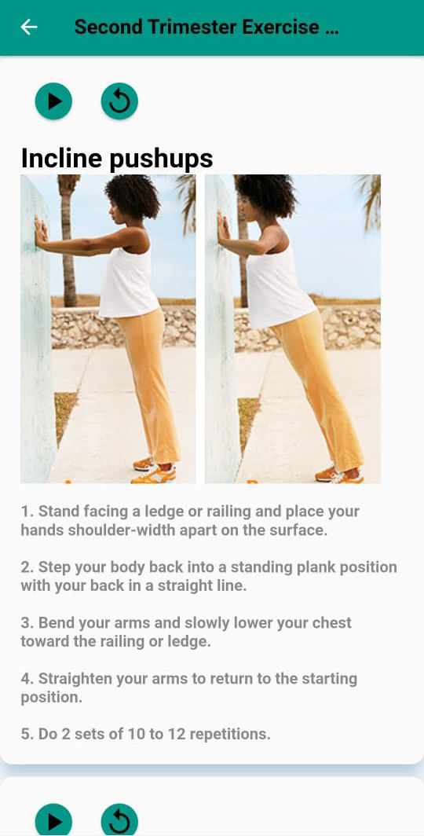
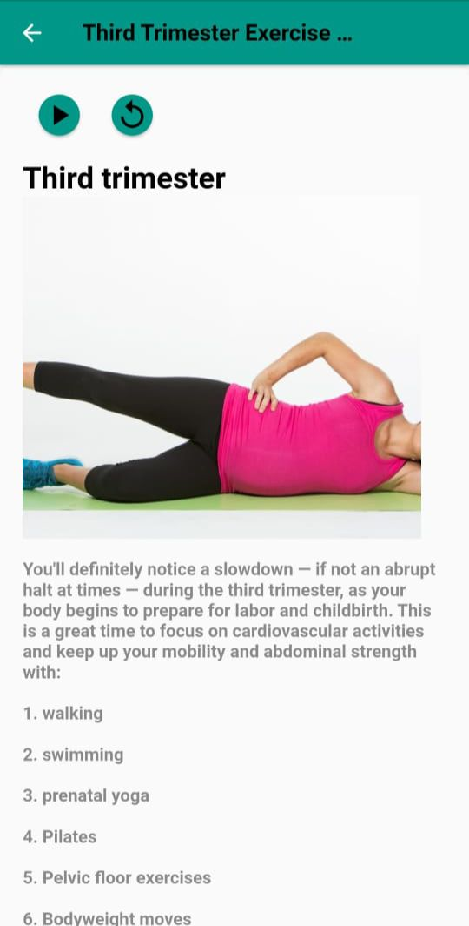
Trimester Wise
Exercises

Slide 14
In this section, the user can set reminders for taking medicines, drink water, doctor appointments and other things.
This is the My Diary section where user can write about her day. How she felt and if she faced any issue. It will help in keeping a track of emotions which is crucial.

Slide 15
PreNatal Care
Contains information how to observe foetus and it’s movements.
Diet and Nutrition Tips during pregnancy
All the information and guide during your pregnancy journey on a single platform.
Guidelines and precautions a pregnant woman should follow
Gives information how you should prepare for delivery
Gives potential warning signs during pregnancy and receive guidance on when to seek medical attention
Access a range of self-care resources

Slide 16
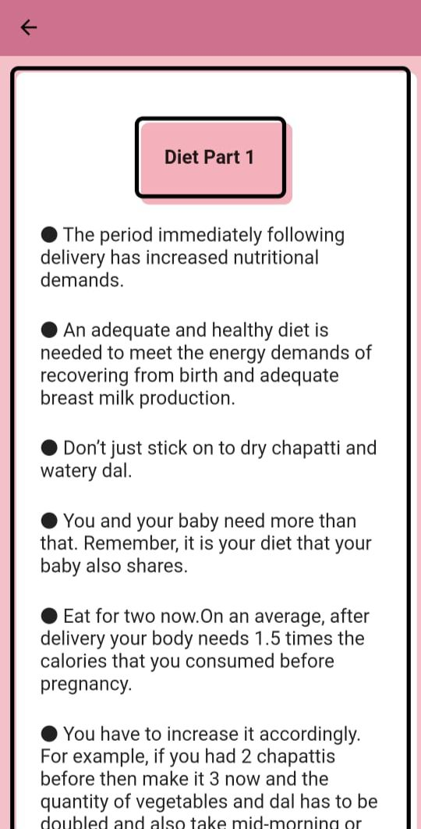
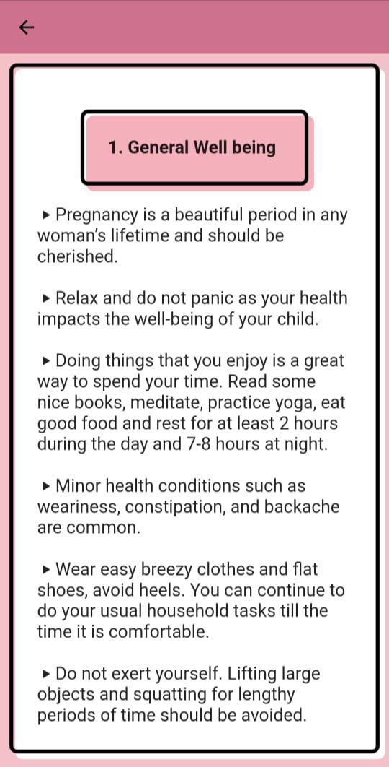
Postnatal: Diet and nutrition articles, guidelines for recommended nutritional values
Prenatal, diet and nutrition guidelines

Slide 17
PostNatal Care
Diet and Nutrition Tips after childbirth to replenish nutrients of mother
Comprehensive guide to breastfeeding, including tips, techniques.
All the information for the mother after childbirth on a single platform.
Postpartum hygiene practices, self-care routines, and tips
Explore family planning options and resources
Postpartum warning signs and symptoms that may indicate complications
Guidance on concerns such as mood changes, physical recovery, and adjusting to parenthood
Exercises designed to aid your postpartum recovery,
Info about reproductive health, contraception, and sexual wellness after childbirth

Slide 18
Generates Report in form of excel sheet based on the data entered in various tools.
Tools
This sections has following tools - Hydration tracker, Sleep Tracker, Fetal Count, Contraction Timer, BMI Calculator and Weight Tracker. A report is generated by the app which can be shared with the doctor.
Track weight throughout pregnancy and postpartum period, providing valuable insights
Stay adequately hydrated by tracking your daily water intake

Slide 19
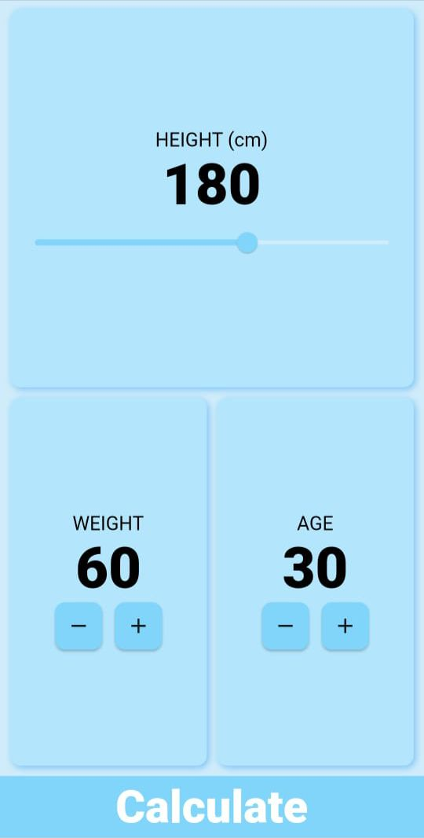
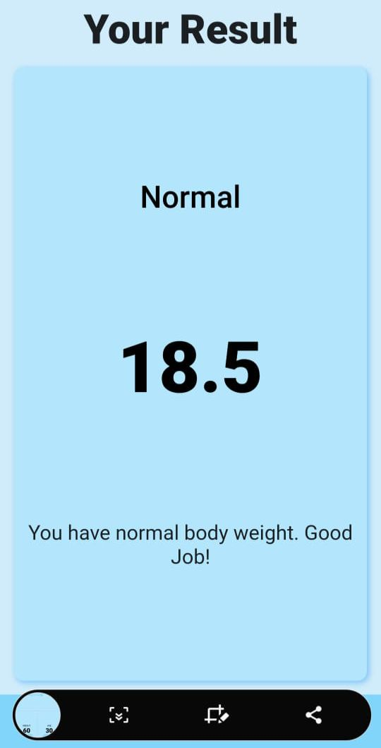
BMI Calculator
All the information for the baby care and growth for new mothers to take proper care of infant’s well being.

Slide 20
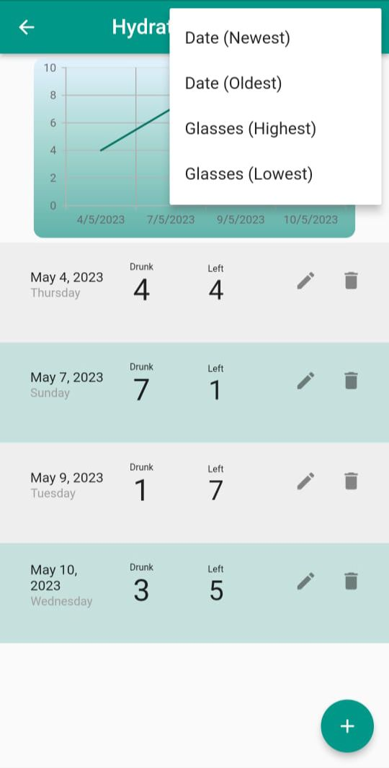
Sort the data according to Date/Quantity
Pin Trackers
Weight record of previous entry
Hydration record representing Number of glasses drunk and left
Add the new entry

Slide 21
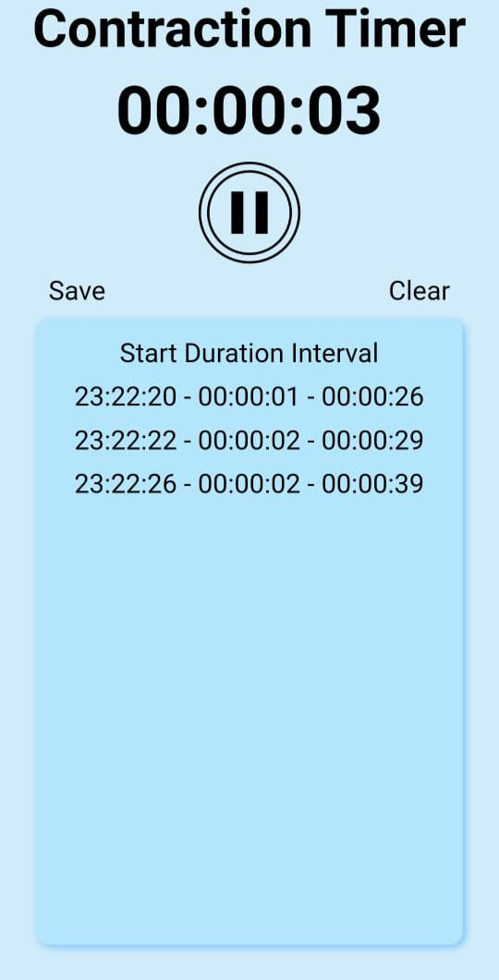
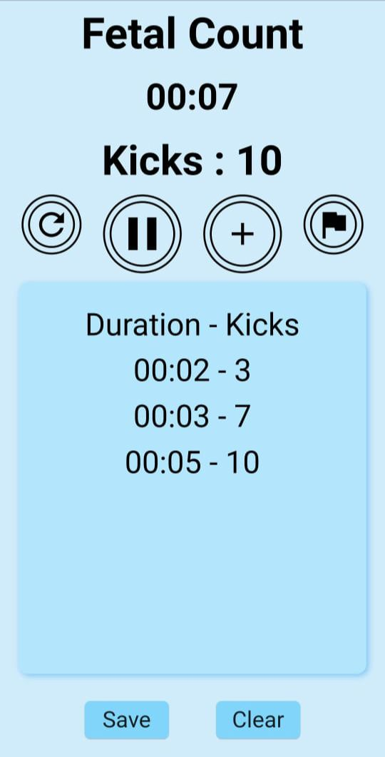
Timer for measuring the contraction duration
Entries consisting of start Time and duration of the contraction.
Restart Timer
Save Button
Clear Button
Pause
Flag
Entry representing Duration and kicks

Slide 22
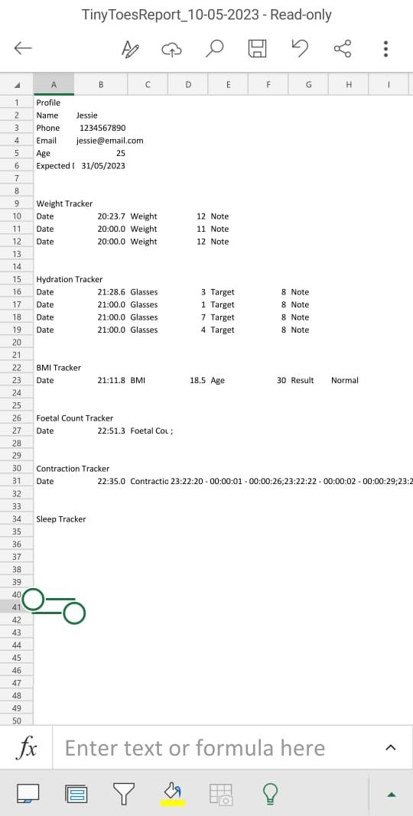
Report Generation
The user can download the report in excel format. The report is generated based on the data that we enter into different tools like Hydration tracker, sleep tracker, contraction timer, etc. This can be shared with doctor who ca analyse the health of foetus as well as your daily intakes.

Slide 23
NeoNatal Care
All the information for the baby care and growth for new mothers to take proper care of infant’s well being.
Stay informed about postpartum warning signs and symptoms
Access a comprehensive guide to breastfeeding, including tips, techniques
Stay up-to-date with the recommended immunization schedule
Learn about proper baby care practices

Slide 24
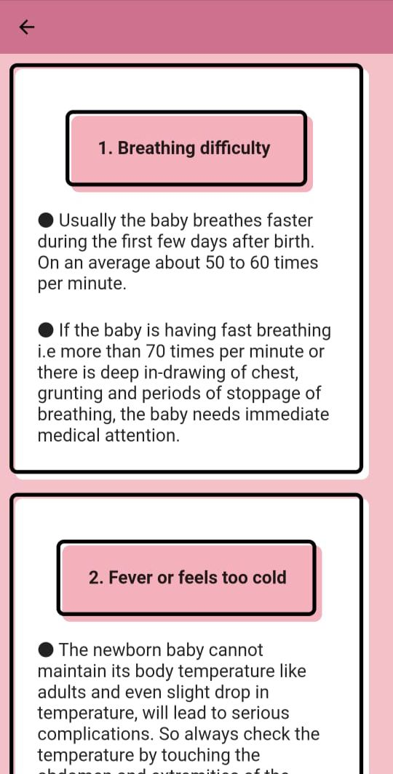
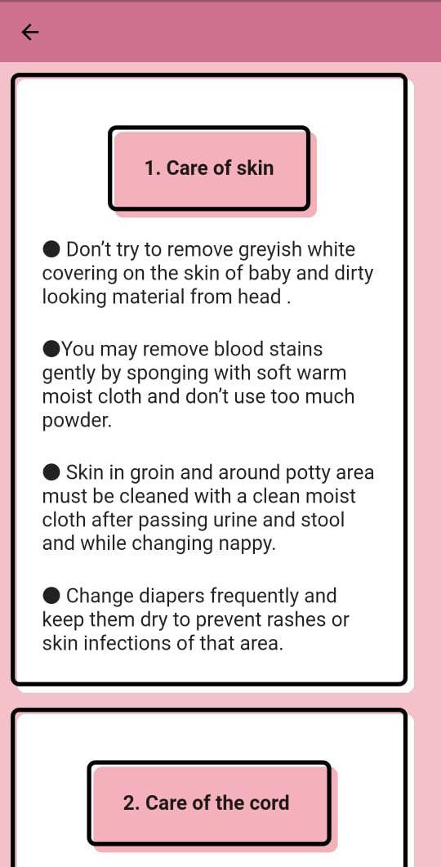
In Danger Sign Section, articles like Breathing difficulty and Fever
In newborn Hygiene, articles like Care of skin and cord

Slide 25
Using the app, you can to know about all the nearby hospitals in just couple of clicks. This makes it very convenient to find them in case of emergency
Nearby Hospitals
Click here to refresh and get you current location.
This button takes the aforementioned location and redirects to the map with nearby hospitals

Slide 26
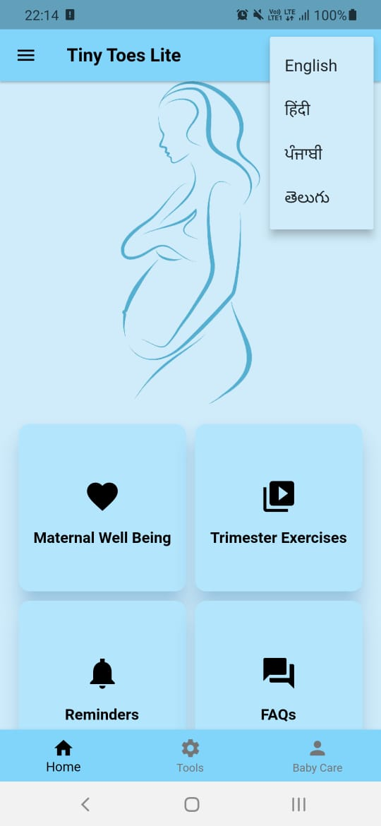
MULTILINGUAL SUPPORT
Our app provides multilingual support and is available in 4 languages - English, Hindi, Punjabi and Telugu. All the articles are available in above mentioned languages

Slide 27
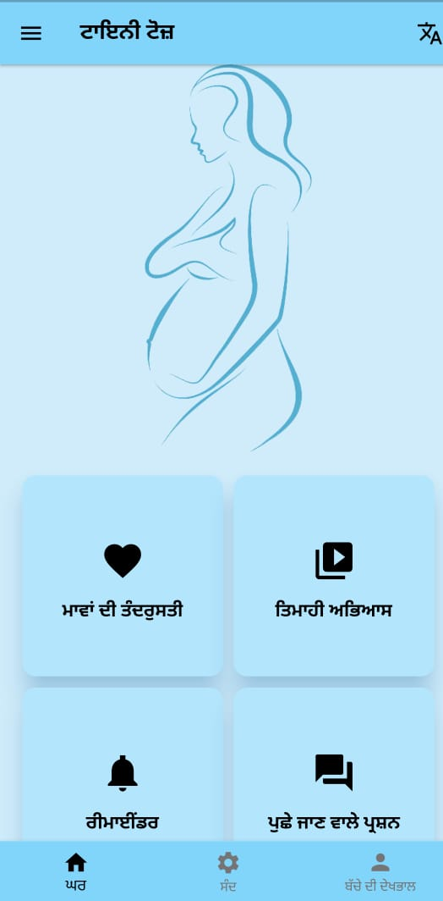
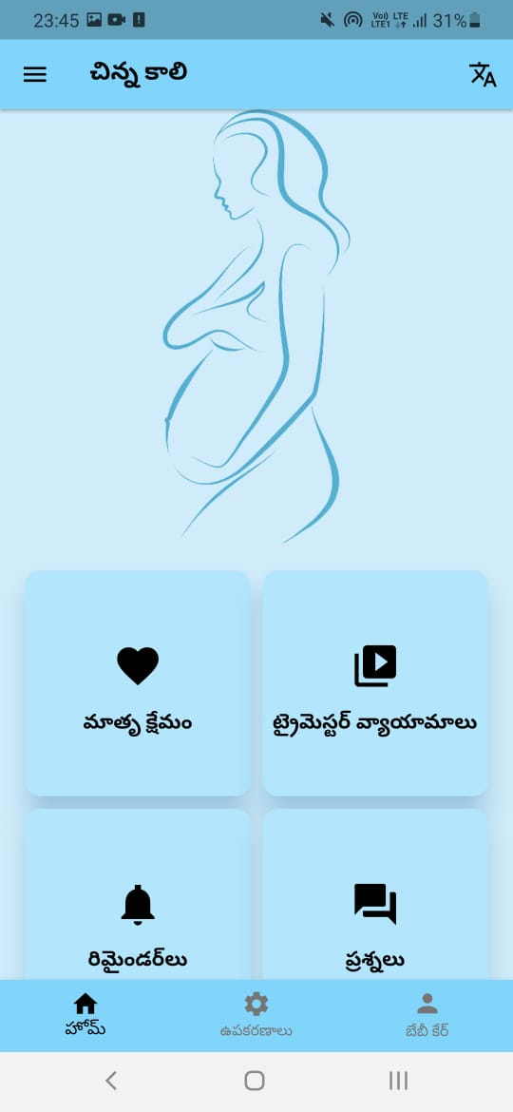
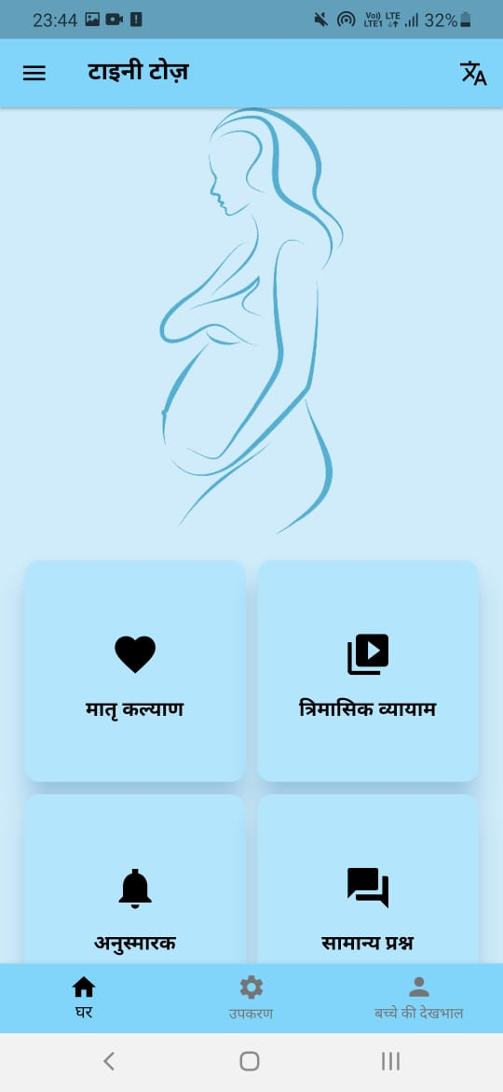
Hindi
Telugu
Punjabi

Slide 28
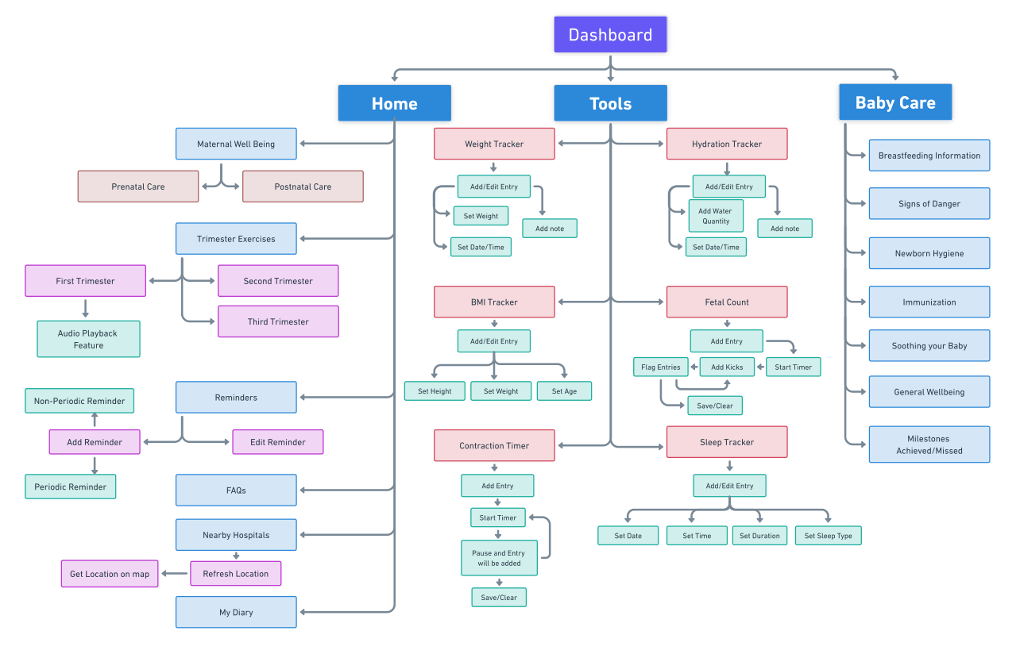
WORKFLOW

Slide 29
WORKFLOW
After the splash screen we will have Home Screen where we have Maternal Well Being, Reminder, FAQs, My Diary, Maps and Trimester wise Exercise Recommendations. All these features have already been described.
On clicking Trimester Exercises, we are provided with three options - first, second and third trimester exercises. All these exercises have instructions along with image illustrations and multilingual audio support.
In the FAQ section, the user can find to all the general queries during and after pregnancy.
In the reminder section we can set reminders for different purposes - appointment with doctor, medicine intake, etc.
In My Diary section, the user can enter the daily symptoms and mood and other information like cravings, headache, feelings, etc.
The Map section helps you locate nearby hospitals around your location in case of emergency.

Slide 30
WORKFLOW
On selecting Maternal Well being we further land on a page that provides us with two options - PreNatal Care and PostNatal Care.
The PreNatal Section consists of following sections - Diet & Nutrition, Self Care, Delivery Preparedness, COVID Precautions, foetal surveillance and Signs of Danger.
In the PostNatal Section we have - Breastfeeding Guide, Diet & Nutrition, Family Planning, Hygiene & Self Care, Exercises, Postpartum Concerns, Reproductive & Sexual Health and Signs of Danger.
Clicking on the Baby icon will take you to NeoNatal care that provides you will all the basic information required to take care of infant. It comprises of the sections - Breastfeeding, Danger Signs, Hygiene, Immunization, Milestones, Play and Communication, Soothing Baby and general section.

Slide 31
WORKFLOW
On clicking on the top left corner of home page we have the option of edit profile, view About Us page and trackers that we have pinned are also available here.
Clicking on the tools section takes user to the tools offered by Tiny Toes namely - Hydration Tracker, Sleep Tracker, BMI Calculator, Fetal Count, Contraction timer and weight Tracker.
User can also generate the report of the data entries entered in various tools by clicking on the top right corner of the Tools page. The format of report is excel sheet.

Slide 32
Technology Stack
Flutter
In-app storage using shared preferences
Google map api for finding nearby hospitals

Slide 33
Packages used
flutter_local_notifications : for sending notifications by reminder
flutter_tts : for text-to-speech conversion of exercises
geolocator and geocoding : for getting the current location
shared_preferences : for in-app storage
permission_handler : for requesting permission for location and storage
filesystem_picker : for picking download folder for report
url_launcher : for linking google map and tinytoes website

Slide 34
Our updates to
App

Slide 35
Feature | Version1 (By seniors) | Version2 (Before midsem) | Version3 (Current version)
Overall code | Unorganized code No backend Outdated flutter version | Well organized code In-app data storage Recent flutter version | Well organized code In-app data storage Recent flutter version
Tools - weight tracker, fetal count, bmi tracker, hydration traction, contraction timer, sleep tracker | All tools present. Data not stored. | All tools present Data stored in- app | All tools present Data stored in-app Edit, delete feature Pin to dashboard Graph and sorting Report download

Slide 36
Feature | Version1 (By seniors) | Version2 (Before midsem) | Version3 (Current version)
Map | Present and Working | Present and Working | Present and Working
Reminder | Present but not functional | Can set one time reminder only | One time and periodic reminders
My Diary, FAQ section | Not present | Not present | Present
Exercises | Text-to-speech only for one exercise and not working correctly | Text-to-speech available for all exercises with play, pause and replay option. | Images added for all exercises Text-to-speech available for all exercises with play, pause and replay option.
Multilingual support | Hindi, Punjabi and English | Hindi, Punjabi, English and Telugu | Hindi, Punjabi, English and Telugu

Slide 37
Feature | Version1 (By seniors) | Version2 (Before midsem) | Version3 (Current version)
Profile Page | Present but data not stored | Not present | Present with data storage, image upload and check on validity of email and phone number
Authorization | Using Firebase | Not present | Not present
UI | Not consistent | Consistent but different colors and rectangular tiles | Consistent, blue-pink theme, square tiles
Deployment status | Not deployed | Not deployed | Deployed on playstore (Link)

Slide 38
Individual Contributions
Arshdeep Singh: 2020CSB1074 (C)
Version compatibility
Code refactoring and language module extraction
Addition of text-to-speech feature for exercises
BabyCare section of Tiny Toes
Reminder scheduling
Graphs for tools
Report download
UI

Slide 39
Individual Contributions
Ayushi Patel: 2020CSB1080
Analysing available apps and features available
Research on new features to be added in the app
UI and Articles of Tiny Toes
Language translation
FAQ section
Images for the app
Language review

Slide 40
Individual Contributions
Inayat Kaur: 2020CSB1088
Code refactoring and language module extraction
In-app data storage for all trackers
Addition of text-to-speech feature for exercises
Reminder and UI of TinyToes
Profile Page
Pin to dashboard
Edit, delete and sorting option for tools

Slide 41
Individual Contributions
Ruchika Sharma: 2020CSB1119
Analysing available apps and features available
Addition of one more language
Research on new features to be added in the app
UI and Articles section of Tiny Toes
My Diary feature added and map feature updated
Profile page
Pin to dashboard

Slide 42
Download the App
Link

Slide 43
THANK YOU

